Slide 1

Pemodelan Data Panel
Farit Mochamad Afendi
08128592194 – fmafendi@apps.ipb.ac.id
Disampaikan pada:
Workshop “Analisis Statistik dengan Aplikasi R”
The Westin Hotel Jakarta
7-9 Agustus 2019

Slide 2
Jenis Data
Cross section
Beberapa pengamatan diamati bersama-sama pada periode waktu tertentu
Time Series
Satu pengamatan diamati selama sekian periode secara teratur
Longitudinal/panel
Beberapa pengamatan diamati bersama-sama selama kurun waktu tertentu (gabungan cross section dan time series)

Slide 3
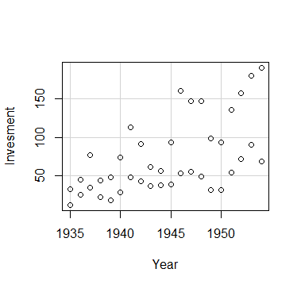
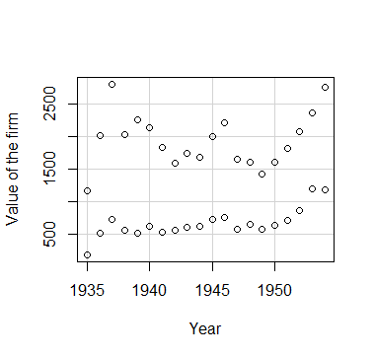
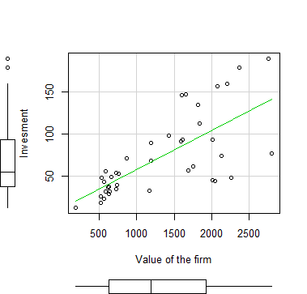
Pemodelan data
Respon
=
Sistematik
+
Error

Slide 4
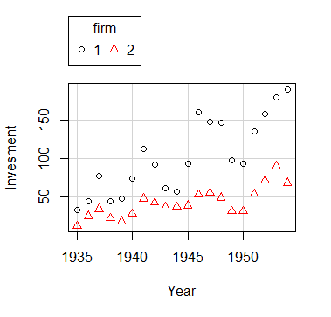
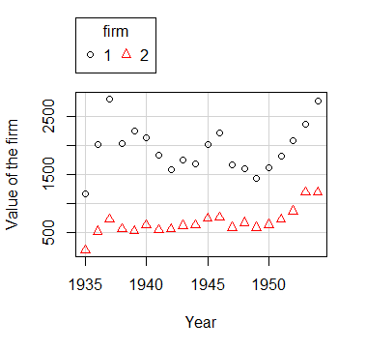
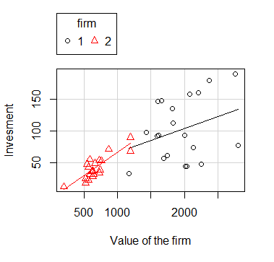
Pemodelan data
Respon
=
Sistematik
+
Error

Slide 5
Data Panel
country | year | Y | X1 | X2 | X3
1 | 2000 | 6 | 7.8 | 5.8 | 1.3
1 | 2001 | 4.6 | 0.6 | 7.9 | 7.8
1 | 2002 | 9.4 | 2.1 | 5.4 | 1.1
2 | 2000 | 9.1 | 1.3 | 6.7 | 4.1
2 | 2001 | 8.3 | 0.9 | 6.6 | 5
2 | 2002 | 0.6 | 9.8 | 0.4 | 7.2
3 | 2000 | 9.1 | 0.2 | 2.6 | 6.4
3 | 2001 | 4.8 | 5.9 | 3.2 | 6.4
3 | 2002 | 9.1 | 5.2 | 6.9 | 2.1
Data yang diperoleh pada beberapa periode waktu dari beberapa amatan sekaligus
Perlu penanganan khusus disebabkan keragaman perilaku antar amatan dan atau antar waktu yang harus diakomodir dalam analisis

Slide 6
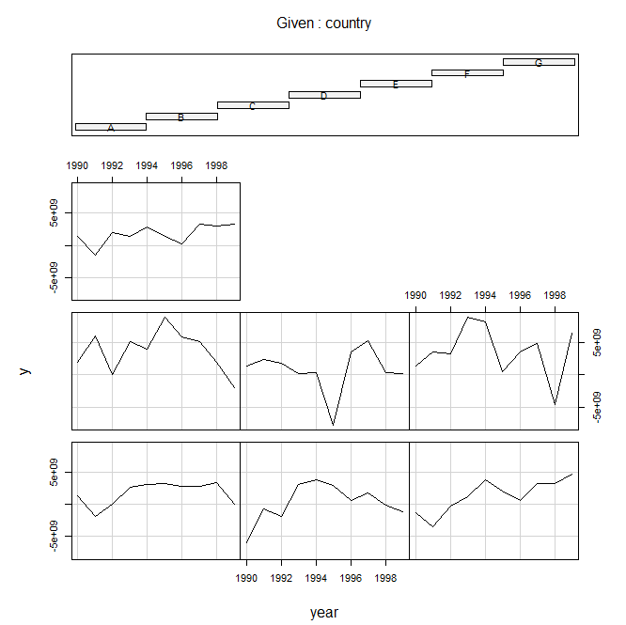
Eksplorasi data panel
setwd("D:/FMA/2019/OJK")
Panel <- read.csv("Data Panel.csv")
coplot(y ~ year|country, type="l", data=Panel) # Lines
coplot(y ~ year|country, type="b", data=Panel) # Points and lines

Slide 7
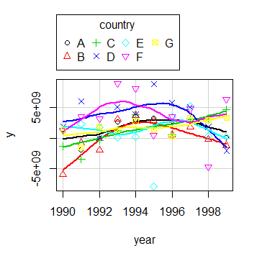
Eksplorasi data panel
library(car)
scatterplot(y~year|country, boxplots=FALSE, smooth=TRUE, reg.line=FALSE, data=Panel)

Slide 8
FIXED-EFFECTS MODEL (Covariance Model, Within Estimator, Individual Dummy Variable Model, Least Squares Dummy Variable Model)

Slide 9
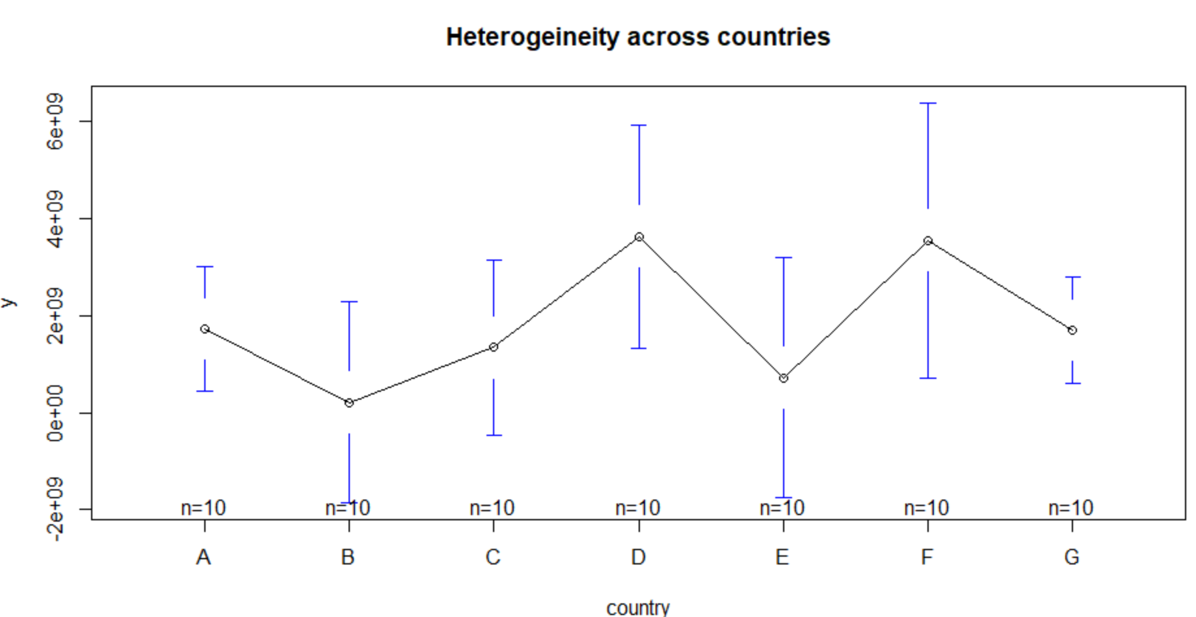
Fixed effects: Heterogeneity across countries (or entities)
library(gplots)
plotmeans(y ~ country, main="Heterogeineity across countries", data=Panel)
Heterogeneity: unobserved variables that do not change over time

Slide 10
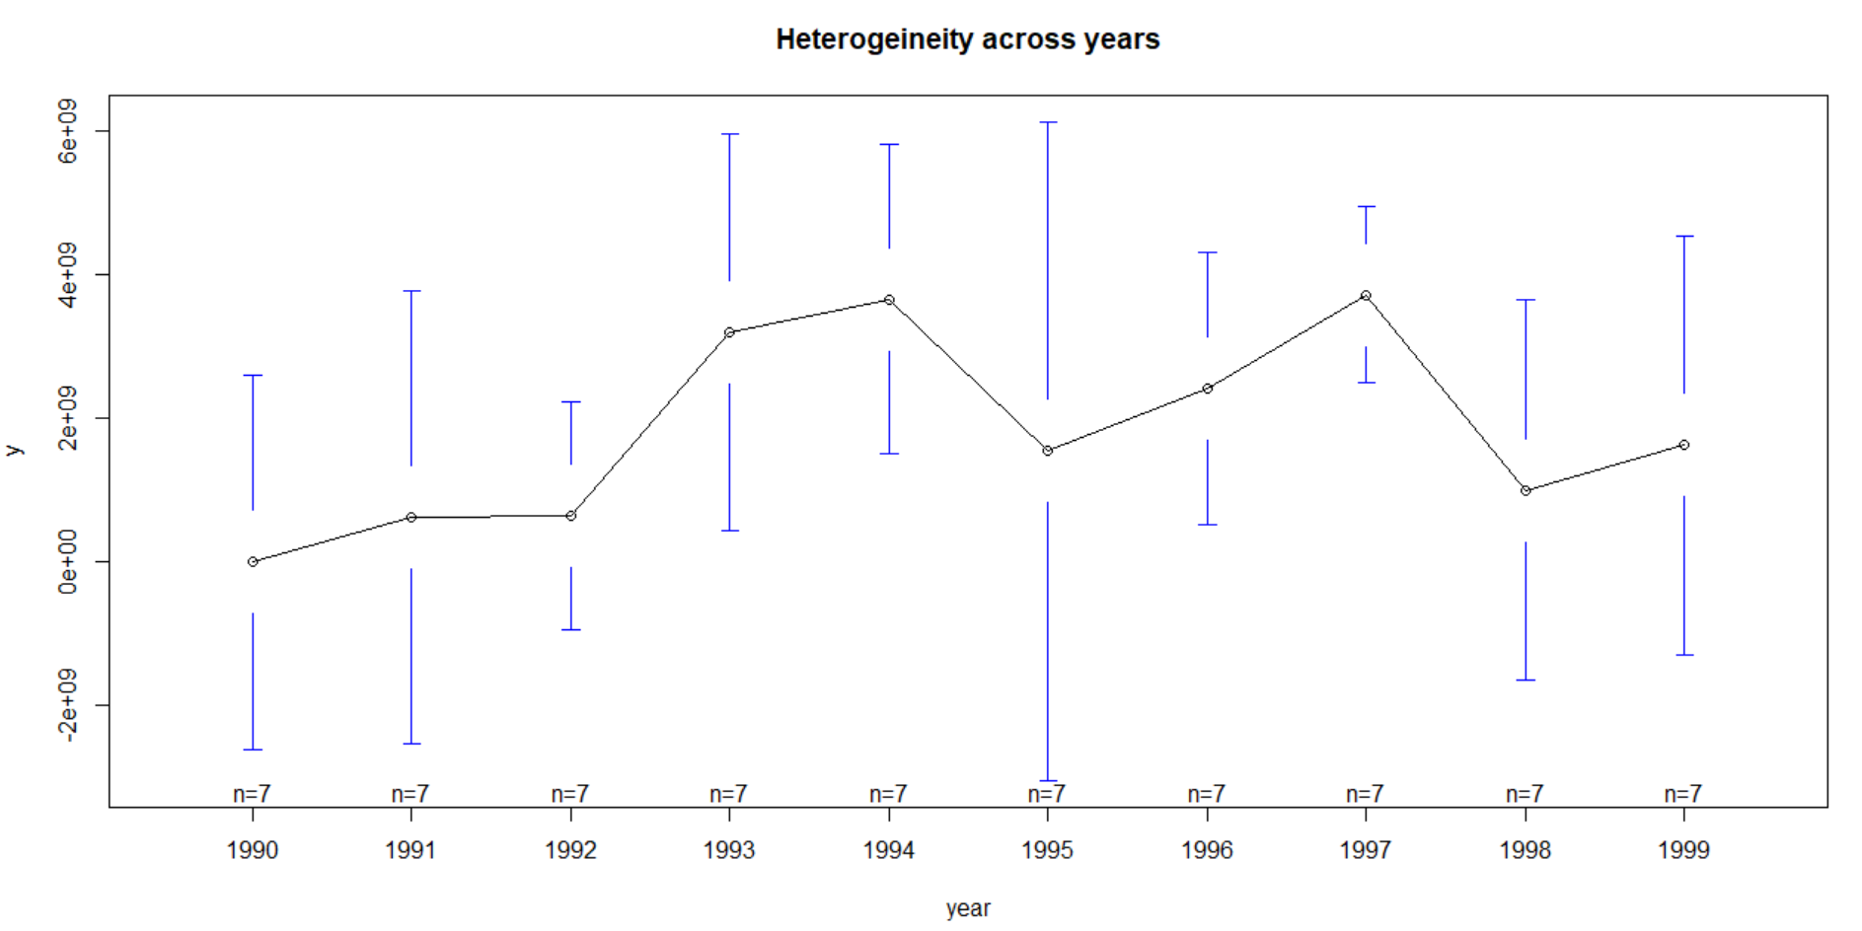
Fixed effects: Heterogeneity across years
plotmeans(y ~ year, main="Heterogeineity across years", data=Panel)
Heterogeneity: unobserved variables that do not change over time

Slide 11
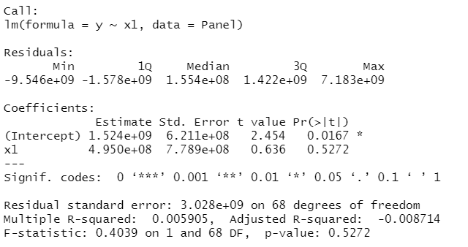
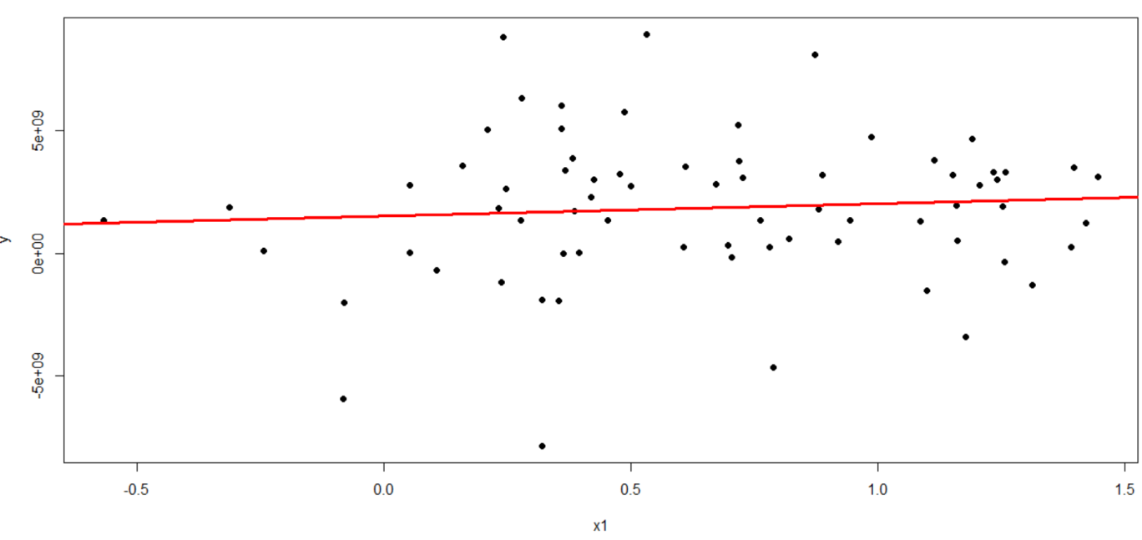
OLS Regression
ols <-lm(y ~ x1, data=Panel) summary(ols) yhat <- ols$fitted plot(Panel$x1, Panel$y, pch=19, xlab="x1", ylab="y") abline(lm(Panel$y~Panel$x1),lwd=3, col="red")
Regular OLS regression does not consider heterogeneity across groups or time

Slide 12

Respon
=
Sistematik
+
Error
Y
X1
Keragaman antar amatan
Random error
Dapat menimbulkan bias dalam model
Perlu dimasukkan dalam komponen sistematik
Model pengaruh tetap memberikan tawaran solusi:
Bentuk lain bila menggunakan peubah biner sebagai representasi amatan

Slide 13
Model pengaruh tetap
Digunakan untuk menangkap pengaruh peubah yang perilakunya berubah seiring perubahan waktu
Karakter tiap amatan unik, dan dikhawatirkan berkorelasi dengan X dan berdampak dugaan model menjadi berbias bila karakter amatan diabaikan dalam model.

Slide 14
Fixed effects using Least squares dummy variable model
fixed.dum <-lm(y ~ x1 + factor(country) - 1, data=Panel)
summary(fixed.dum)
Call:
lm(formula = y ~ x1 + factor(country) - 1, data = Panel)
Residuals:
Min 1Q Median 3Q Max
-8.634e+09 -9.697e+08 5.405e+08 1.386e+09 5.612e+09
Coefficients:
Estimate Std. Error t value Pr(>|t|)
x1 2.476e+09 1.107e+09 2.237 0.02889 *
factor(country)A 8.805e+08 9.618e+08 0.916 0.36347
factor(country)B -1.058e+09 1.051e+09 -1.006 0.31811
factor(country)C -1.723e+09 1.632e+09 -1.056 0.29508
factor(country)D 3.163e+09 9.095e+08 3.478 0.00093 ***
factor(country)E -6.026e+08 1.064e+09 -0.566 0.57329
factor(country)F 2.011e+09 1.123e+09 1.791 0.07821 .
factor(country)G -9.847e+08 1.493e+09 -0.660 0.51190
---
Signif. codes: 0 ‘***’ 0.001 ‘**’ 0.01 ‘*’ 0.05 ‘.’ 0.1 ‘ ’ 1
Residual standard error: 2.796e+09 on 62 degrees of freedom
Multiple R-squared: 0.4402, Adjusted R-squared: 0.368
F-statistic: 6.095 on 8 and 62 DF, p-value: 8.892e-06
Notes:
For the theory behind fixed effects, please see http://dss.princeton.edu/training/Panel101.pdf

Slide 15
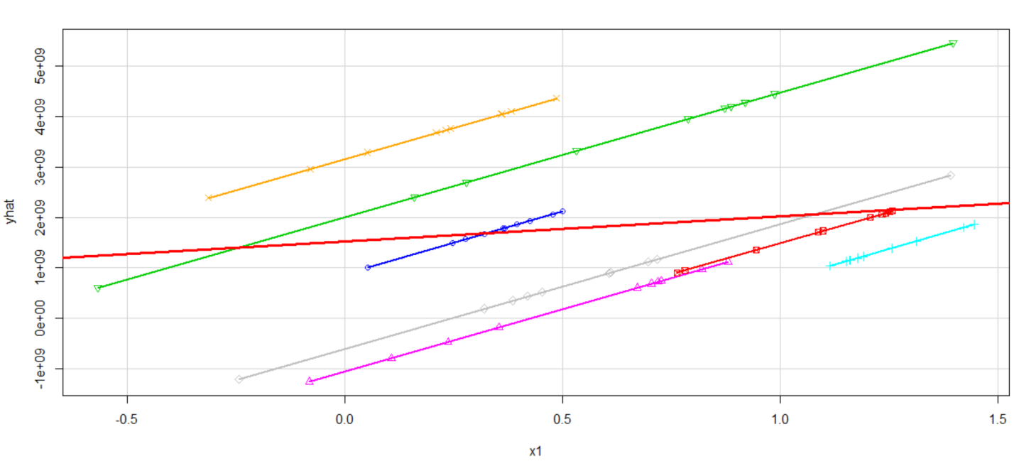
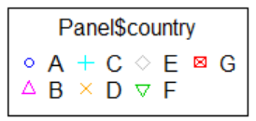
Least squares dummy variable model
yhat <- fixed.dum$fitted
library(car)
scatterplot(yhat~Panel$x1|Panel$country, boxplots=FALSE, xlab="x1", ylab="yhat",smooth=FALSE)
abline(lm(Panel$y~Panel$x1),lwd=3, col="red")
OLS regression
OLS regression

Slide 16
Comparing OLS vs LSDV model
Each component of the factor variable (country) is absorbing the effects particular to each country. Predictor x1 was not significant in the OLS model, once controlling for differences across countries, x1 became significant in the OLS_DUM (i.e. LSDV model).
library(apsrtable)
apsrtable(ols,fixed.dum, model.names = c("OLS", "OLS_DUM")) # Displays a table in Latex form
& \multicolumn{ 1 }{ c }{ OLS } & \multicolumn{ 1 }{ c }{ OLS_DUM } \\ \hline
% & OLS & OLS_DUM \\
(Intercept) & 1524319070.05 ^* & \\
& (621072623.86) & \\
x1 & 494988913.90 & 2475617827.10 ^*\\
& (778861260.95) & (1106675593.60) \\
factor(country)A & & 880542403.99 \\
& & (961807052.24) \\
factor(country)B & & -1057858363.16 \\
& & (1051067684.19) \\
factor(country)C & & -1722810754.55 \\
& & (1631513751.40) \\
factor(country)D & & 3162826897.32 ^*\\
& & (909459149.66) \\
factor(country)E & & -602622000.33 \\
& & (1064291684.41) \\
factor(country)F & & 2010731793.24 \\
& & (1122809097.35) \\
factor(country)G & & -984717493.45 \\
& & (1492723118.24) \\
$N$ & 70 & 70 \\
$R^2$ & 0.01 & 0.44 \\
adj. $R^2$ & -0.01 & 0.37 \\
Resid. sd & 3028276248.26 & 2795552570.60 \\ \hline
\multicolumn{3}{l}{\footnotesize{Standard errors in parentheses}}\\
\multicolumn{3}{l}{\footnotesize{$^*$ indicates significance at $p< 0.05 $}}
\end{tabular}
\end{table}
The coefficient of much Y changes when x1 indicates how X increases by one unit. Notice x1 is not significant in
the OLS model
The coefficient of x1 indicates how much Y changes overtime, controlling by differences in countries, when X increases by one unit. Notice x1 is significant in the LSDV model

Slide 17
Fixed effects: n entity-specific intercepts (using plm)
Outcome Variable
Panel setting
Fixed effects option
library(plm)
fixed <- plm(y ~ x1, data=Panel, index=c("country", "year"), model="within")
summary(fixed)
Oneway (individual) effect Within Model
Call:
plm(formula = y ~ x1, data = Panel, model = "within", index = c("country",
"year"))
Balanced Panel: n = 7, T = 10, N = 70
Residuals:
Min. 1st Qu. Median Mean 3rd Qu. Max.
-8.63e+09 -9.70e+08 5.40e+08 0.00e+00 1.39e+09 5.61e+09
Coefficients:
Estimate Std. Error t-value Pr(>|t|)
x1 2475617827 1106675594 2.237 0.02889 *
---
Signif. codes: 0 ‘***’ 0.001 ‘**’ 0.01 ‘*’ 0.05 ‘.’ 0.1 ‘ ’ 1
Total Sum of Squares: 5.2364e+20
Residual Sum of Squares: 4.8454e+20
R-Squared: 0.074684
Adj. R-Squared: -0.029788
F-statistic: 5.00411 on 1 and 62 DF, p-value: 0.028892
Predictor
variable(s)
n = # of groups/panels, T = # years, N = total # of observations
The coeff of x1 indicates how much Y changes overtime, on average per country, when X increases by one unit
Pr(>|t|)= Two-tail p-values test the hypothesis that each coefficient is different from 0. To reject this, the p-value has to be lower than 0.05 (95%, you could choose also an alpha of 0.10), if this is the case then you can say that the variable has a significant influence on your dependent variable (y)
If the p-value is < 0.05 then the fixed effects model is a better choice

Slide 18
Fixed effects: n entity-specific intercepts (using plm)
fixef(fixed) # Display the fixed effects (constants for each country)
A B C D E F G
880542404 -1057858363 -1722810755 3162826897 -602622000 2010731793 -984717493
pFtest(fixed, ols) # Testing for fixed effects, null: OLS better than fixed
F test for individual effects
data: y ~ x1
F = 2.9655, df1 = 6, df2 = 62, p-value = 0.01307
alternative hypothesis: significant effects
If the p-value is < 0.05 then the fixed effects model is a better choice

Slide 19
RANDOM-EFFECTS MODEL (Random Intercept, Partial Pooling Model)

Slide 20
Model pengaruh acak
Model pengaruh tetap:
sesuatu di dalam amatan dikhawatirkan berdampak pada pengaruh X terhadap Y
karakter tiap amatan unik
Model pengaruh acak
mengasumsikan keragaman antar amatan bersifat acak dan tidak berkorelasi dengan X,
Karakter yang tidak berubah seiring peubahan waktu dapat dimasukkan dalam model

Slide 21
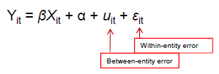
Model pengaruh acak

Slide 22
RANDOM-EFFECTS MODEL (Random Intercept, Partial Pooling Model)
random <- plm(y ~ x1, data=Panel, index=c("country", "year"), model="random")
summary(random)
Oneway (individual) effect Random Effect Model
(Swamy-Arora's transformation)
Call:
plm(formula = y ~ x1, data = Panel, model = "random", index = c("country",
"year"))
Balanced Panel: n = 7, T = 10, N = 70
Effects:
var std.dev share
idiosyncratic 7.815e+18 2.796e+09 0.873
individual 1.133e+18 1.065e+09 0.127
theta: 0.3611
Residuals:
Min. 1st Qu. Median Mean 3rd Qu. Max.
-8.94e+09 -1.51e+09 2.82e+08 0.00e+00 1.56e+09 6.63e+09
Coefficients:
Estimate Std. Error z-value Pr(>|z|)
(Intercept) 1037014284 790626206 1.3116 0.1896
x1 1247001782 902145601 1.3823 0.1669
Total Sum of Squares: 5.6595e+20
Residual Sum of Squares: 5.5048e+20
R-Squared: 0.02733
Adj. R-Squared: 0.013026
Chisq: 1.91065 on 1 DF, p-value: 0.16689
random effects option
n = # of groups/panels, T = # years, N = total # of observations
Interpretation of the coefficients is tricky since they include both the within-entity and between-entity effects. In the case of TSCS data represents the average effect of X over Y when X changes across time and between countries by one unit.
Pr(>|t|)= Two-tail p-values test the hypothesis that each coefficient is different from 0. To reject this, the p-value has to be lower than 0.05 (95%, you could choose also an alpha of 0.10), if this is the case then you can say that the variable has a significant influence on your dependent variable (y)
If this number is < 0.05 then your model is ok. This is a test
(F) to see whether all the coefficients in the model are different than zero.

Slide 23
RANDOM-EFFECTS MODEL (Random Intercept, Partial Pooling Model)
# Setting as panel data (an alternative way to run the above model
Panel.set <- plm.data(Panel, index = c("country", "year"))
# Random effects using panel setting (same output as above)
random.set <- plm(y ~ x1, data = Panel.set, model="random")
summary(random.set)
Oneway (individual) effect Random Effect Model
(Swamy-Arora's transformation)
Call:
plm(formula = y ~ x1, data = Panel.set, model = "random")
Balanced Panel: n = 7, T = 10, N = 70
Effects:
var std.dev share
idiosyncratic 7.815e+18 2.796e+09 0.873
individual 1.133e+18 1.065e+09 0.127
theta: 0.3611
Residuals:
Min. 1st Qu. Median Mean 3rd Qu. Max.
-8.94e+09 -1.51e+09 2.82e+08 0.00e+00 1.56e+09 6.63e+09
Coefficients:
Estimate Std. Error z-value Pr(>|z|)
(Intercept) 1037014284 790626206 1.3116 0.1896
x1 1247001782 902145601 1.3823 0.1669
Total Sum of Squares: 5.6595e+20
Residual Sum of Squares: 5.5048e+20
R-Squared: 0.02733
Adj. R-Squared: 0.013026
Chisq: 1.91065 on 1 DF, p-value: 0.16689

Slide 24
Fixed or Random: Hausman test
To decide between fixed or random effects you can run a Hausman test where the null hypothesis is that the preferred model is random effects vs. the alternative the fixed effects (see Green, 2008, chapter 9). It basically tests whether the unique errors (ui) are correlated with the regressors, the null hypothesis is they are not.
Run a fixed effects model and save the estimates, then run a random model and save the estimates, then perform the test. If the p-value is significant (for example <0.05) then use fixed effects, if not use random effects.
> phtest(fixed, random)
Hausman Test
data: y ~ x1
chisq = 3.674, df = 1, p-value = 0.05527
alternative hypothesis: one model is inconsistent
If this number is < 0.05 then use fixed effects

Slide 25
Testing for time-fixed effects
fixed <- plm(y ~ x1, data=Panel, index=c("country", "year"), model="within")
fixed.time <- plm(y ~ x1 + factor(year), data=Panel, index=c("country", "year"), model="within")
summary(fixed.time)
Oneway (individual) effect Within Model
Call:
plm(formula = y ~ x1 + factor(year), data = Panel, model = "within",
index = c("country", "year"))
Balanced Panel: n = 7, T = 10, N = 70
Residuals:
Min. 1st Qu. Median Mean 3rd Qu. Max.
-7.92e+09 -1.05e+09 -1.40e+08 0.00e+00 1.63e+09 5.49e+09
Coefficients:
Estimate Std. Error t-value Pr(>|t|)
x1 1389050354 1319849567 1.0524 0.29738
factor(year)1991 296381559 1503368528 0.1971 0.84447
factor(year)1992 145369666 1547226548 0.0940 0.92550
factor(year)1993 2874386795 1503862554 1.9113 0.06138 .
factor(year)1994 2848156288 1661498927 1.7142 0.09233 .
factor(year)1995 973941306 1567245748 0.6214 0.53698
factor(year)1996 1672812557 1631539254 1.0253 0.30988
factor(year)1997 2991770063 1627062032 1.8388 0.07156 .
factor(year)1998 367463593 1587924445 0.2314 0.81789
factor(year)1999 1258751933 1512397632 0.8323 0.40898
---
Signif. codes: 0 ‘***’ 0.001 ‘**’ 0.01 ‘*’ 0.05 ‘.’ 0.1 ‘ ’ 1
Total Sum of Squares: 5.2364e+20
Residual Sum of Squares: 4.0201e+20
R-Squared: 0.23229
Adj. R-Squared: 0.00052851
F-statistic: 1.60365 on 10 and 53 DF, p-value: 0.13113

Slide 26
Testing for time-fixed effects
# Testing time-fixed effects. The null is that no time-fixed effects needed
pFtest(fixed.time, fixed)
F test for individual effects
data: y ~ x1 + factor(year)
F = 1.209, df1 = 9, df2 = 53, p-value = 0.3094
alternative hypothesis: significant effects
plmtest(fixed, c("time"), type=("bp"))
Lagrange Multiplier Test - time effects (Breusch-Pagan) for balanced panels
data: y ~ x1
chisq = 0.16532, df = 1, p-value = 0.6843
alternative hypothesis: significant effects
If this number is < 0.05 then use time-fixed effects. In this example, no need to use time-fixed effects.

Slide 27
Testing for random effects: Breusch-Pagan Lagrange multiplier (LM)
# Regular OLS (pooling model) using plm
pool <- plm(y ~ x1, data=Panel, index=c("country", "year"), model="pooling")
summary(pool)
Pooling Model
Call:
plm(formula = y ~ x1, data = Panel, model = "pooling",
index = c("country", "year"))
Balanced Panel: n = 7, T = 10, N = 70
Residuals:
Min. 1st Qu. Median Mean 3rd Qu. Max.
-9.55e+09 -1.58e+09 1.55e+08 0.00e+00 1.42e+09 7.18e+09
Coefficients:
Estimate Std. Error t-value Pr(>|t|)
(Intercept) 1524319070 621072624 2.4543 0.01668 *
x1 494988914 778861261 0.6355 0.52722
---
Signif. codes: 0 ‘***’ 0.001 ‘**’ 0.01 ‘*’ 0.05 ‘.’ 0.1 ‘ ’ 1
Total Sum of Squares: 6.2729e+20
Residual Sum of Squares: 6.2359e+20
R-Squared: 0.0059046
Adj. R-Squared: -0.0087145
F-statistic: 0.403897 on 1 and 68 DF, p-value: 0.52722
The LM test helps you decide between a random effects regression and a simple OLS regression. The null hypothesis in the LM test is that variances across entities is zero. This is, no significant difference across units (i.e. no panel effect)

Slide 28
Testing for random effects: Breusch-Pagan Lagrange multiplier (LM)
# Breusch-Pagan Lagrange Multiplier for random effects. Null is no panel effect (i.e. OLS better) plmtest(pool, type=c("bp")
Lagrange Multiplier Test - (Breusch-Pagan) for balanced panels
data: y ~ x1
chisq = 2.6692, df = 1, p-value = 0.1023
alternative hypothesis: significant effects)
Here we failed to reject the null and conclude that random effects is not appropriate. This is, no evidence of significant differences across countries, therefore you can run a simple OLS regression.

Slide 29
Testing for cross-sectional dependence/contemporaneous correlation: using Breusch-Pagan LM test of independence and Pesaran CD test
According to Baltagi, cross-sectional dependence is a problem in macro panels with long time series. This is not much of a problem in micro panels (few years and large number of cases).
The null hypothesis in the B-P/LM and Pesaran CD tests of independence is that residuals across entities are not correlated. B-P/LM and Pesaran CD (cross-sectional dependence) tests are used to test whether the residuals are correlated across entities*. Cross sectional dependence can lead to bias in tests results (also called contemporaneous correlation).
fixed <- plm(y ~ x1, data=Panel, index=c("country", "year"), model="within")
pcdtest(fixed, test = c("lm"))
Breusch-Pagan LM test for cross-sectional dependence in panels
data: y ~ x1
chisq = 28.914, df = 21, p-value = 0.1161
alternative hypothesis: cross-sectional dependence
pcdtest(fixed, test = c("cd")) Pesaran CD test for cross-sectional dependence in panels
data: y ~ x1
z = 1.1554, p-value = 0.2479
alternative hypothesis: cross-sectional dependence
No cross-sectional dependence

Slide 30
Testing for serial correlation
Serial correlation tests apply to macro panels with long time series. Not a problem in micro panels (with very few years). The null is that there is not serial correlation.
> pbgtest(fixed)
Breusch-Godfrey/Wooldridge test for serial correlation in panel models
data: y ~ x1
chisq = 14.137, df = 10, p-value = 0.1668
alternative hypothesis: serial correlation in idiosyncratic errors
No serial correlation

Slide 31
Testing for unit roots/stationarity
The Dickey-Fuller test to check for stochastic trends. The null hypothesis is that the series has a unit root (i.e. non-stationary). If unit root is present you can take the first difference of the variable.
Panel.set <- plm.data(Panel, index = c("country", "year"))
library(tseries)
adf.test(Panel.set$y, k=2)
Augmented Dickey-Fuller Test
data: Panel.set$y
Dickey-Fuller = -3.9051, Lag order = 2, p-value = 0.0191
alternative hypothesis: stationary
If p-value < 0.05 then no unit roots present.

Slide 32
Testing for heteroskedasticity
The null hypothesis for the Breusch-Pagan test is homoskedasticity.
If hetersokedaticity is detected you can use robust covariance matrix to account for it. See the following pages.
library(lmtest)
bptest(y ~ x1 + factor(country), data = Panel, studentize=F) Breusch-Pagan test
data: y ~ x1 + factor(country)
BP = 14.606, df = 7, p-value = 0.04139
Presence of heteroskedasticity

Slide 33
Controlling for heteroskedasticity: Robust covariance matrix estimation (Sandwich estimator)
The --vcovHC– function estimates three heteroskedasticity-consistent covariance estimators:
• "white1" - for general heteroskedasticity but no serial correlation. Recommended for random effects.
• "white2" - is "white1" restricted to a common variance within groups. Recommended for random effects.
• "arellano" - both heteroskedasticity and serial correlation. Recommended for fixed effects.
The following options apply*:
• HC0 - heteroskedasticity consistent. The default.
• HC1,HC2, HC3 – Recommended for small samples. HC3 gives less weight to influential observations.
• HC4 - small samples with influential observations
• HAC - heteroskedasticity and autocorrelation consistent (type ?vcovHAC for more details)

Slide 34
Controlling for heteroskedasticity: Random effects
random <- plm(y ~ x1, data=Panel, index=c("country", "year"), model="random")
coeftest(random) # Original coefficients
t test of coefficients:
Estimate Std. Error t value Pr(>|t|)
(Intercept) 1037014284 790626206 1.3116 0.1941
x1 1247001782 902145601 1.3823 0.1714
coeftest(random, vcovHC) # Heteroskedasticity consistent coefficients
t test of coefficients:
Estimate Std. Error t value Pr(>|t|)
(Intercept) 1037014284 907983029 1.1421 0.2574
x1 1247001782 828970247 1.5043 0.1371
coeftest(random, vcovHC(random, type = "HC3")) # Heteroskedasticity consistent coefficients, type 3
t test of coefficients:
Estimate Std. Error t value Pr(>|t|)
(Intercept) 1037014284 943438284 1.0992 0.2756
x1 1247001782 867137585 1.4381 0.1550

Slide 35
Controlling for heteroskedasticity: Random effects
# The following shows the HC standard errors of the coefficients
t(sapply(c("HC0", "HC1", "HC2", "HC3", "HC4"), function(x) sqrt(diag(vcovHC(random, type = x)))))
(Intercept) x1
HC0 907983029 828970247
HC1 921238957 841072643
HC2 925403820 847733474
HC3 943438284 867137584
HC4 941376033 866024033
Standard errors given different types of HC.

Slide 36
Controlling for heteroskedasticity: Fixed effects
fixed <- plm(y ~ x1, data=Panel, index=c("country", "year"), model="within")
coeftest(fixed) # Original coefficients
t test of coefficients:
Estimate Std. Error t value Pr(>|t|)
x1 2475617827 1106675594 2.237 0.02889 *
---
Signif. codes: 0 ‘***’ 0.001 ‘**’ 0.01 ‘*’ 0.05 ‘.’ 0.1 ‘ ’ 1
coeftest(fixed, vcovHC) # Heteroskedasticity consistent coefficients
t test of coefficients:
Estimate Std. Error t value Pr(>|t|)
x1 2475617827 1358388942 1.8225 0.07321 .
---
Signif. codes: 0 ‘***’ 0.001 ‘**’ 0.01 ‘*’ 0.05 ‘.’ 0.1 ‘ ’ 1

Slide 37
Controlling for heteroskedasticity: Fixed effects
# Heteroskedasticity consistent coefficients (Arellano)
coeftest(fixed, vcovHC(fixed, method = "arellano"))
t test of coefficients:
Estimate Std. Error t value Pr(>|t|)
x1 2475617827 1358388942 1.8225 0.07321 .
---
Signif. codes: 0 ‘***’ 0.001 ‘**’ 0.01 ‘*’ 0.05 ‘.’ 0.1 ‘ ’ 1
# Heteroskedasticity consistent coefficients, type 3
coeftest(fixed, vcovHC(fixed, type = "HC3"))
t test of coefficients:
Estimate Std. Error t value Pr(>|t|)
x1 2475617827 1439083523 1.7203 0.09037 .
---
Signif. codes: 0 ‘***’ 0.001 ‘**’ 0.01 ‘*’ 0.05 ‘.’ 0.1 ‘ ’ 1
# The following shows the HC standard errors of the coefficients
t(sapply(c("HC0", "HC1", "HC2", "HC3", "HC4"), function(x) sqrt(diag(vcovHC(fixed, type = )))))
HC0.x1 HC1.x1 HC2.x1 HC3.x1 HC4.x1
[1,] 1358388942 1358388942 1358388942 1358388942 1358388942
Standard errors given different types of HC.

Slide 38
TERIMA KASIH

